Slide 1
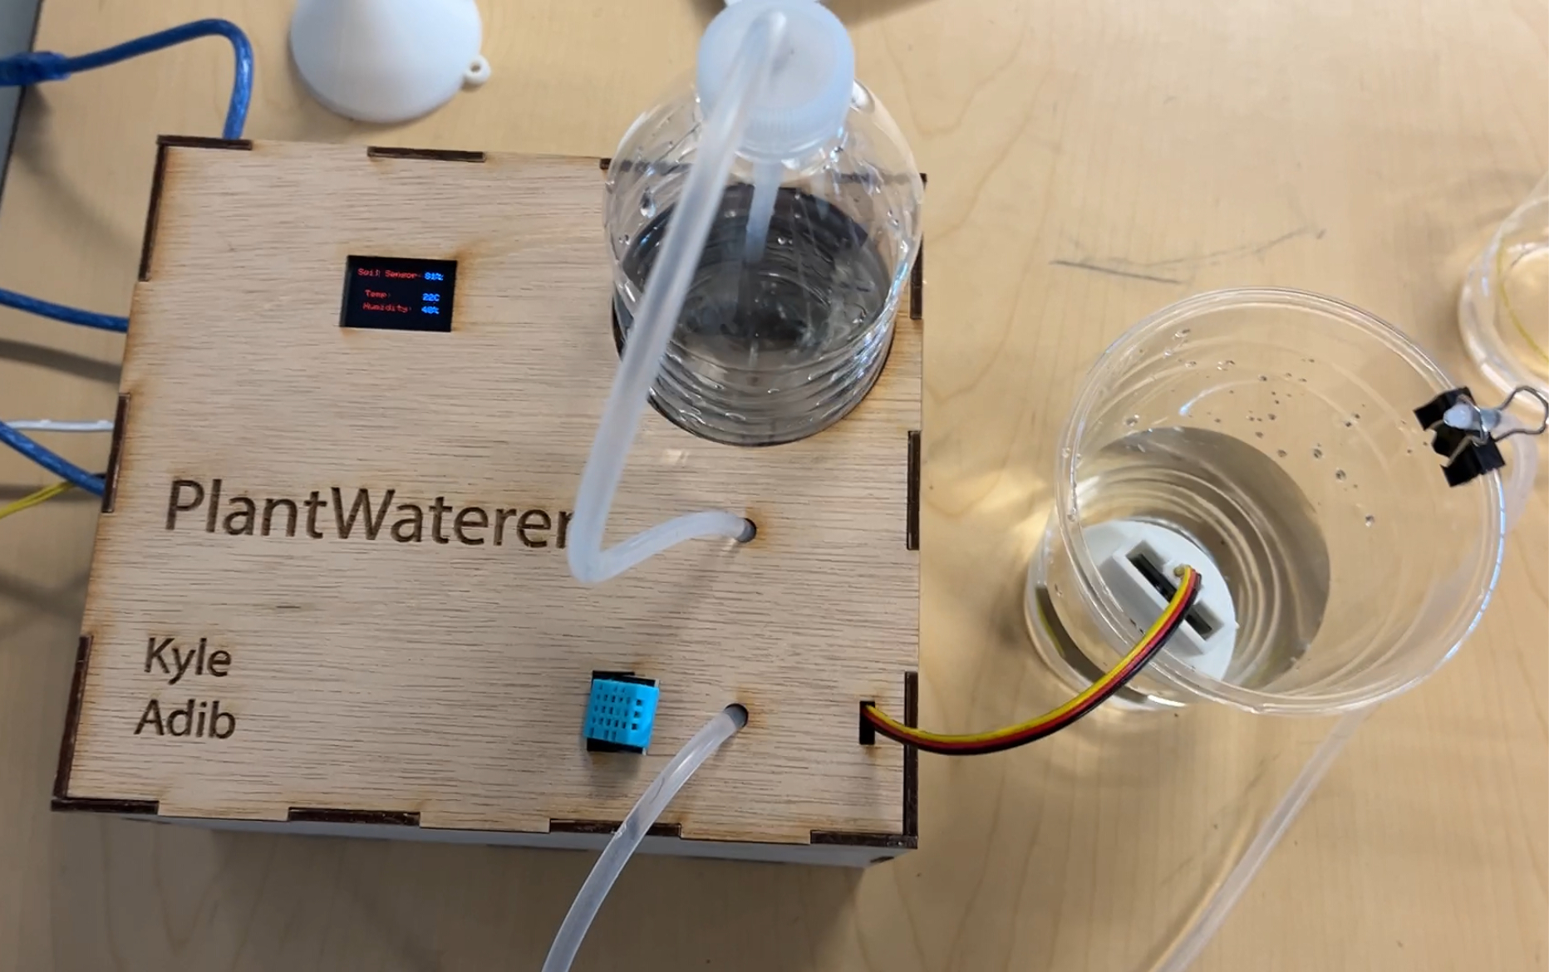
Smart Plant Waterer
Presented by: 🌳Kyle Guo
🌳Adib Hasan

Slide 2
Motivation:
Problem: Not watering plants enough/watering too much -> resulting in plants dying
Solution: Create a device that will water the plant for you, and give you some information about the environment too.
This project will be able to take readings from the soil in a flowerpot and automatically water the plant when readings go too low.

Slide 3
Implementation
Integrated a capacitive soil moisture sensor with a 12V peristaltic pump for automated watering of plants.
Utilized Arduino to control the pump based on soil moisture readings.
Incorporated a relay block to switch the pump on/off via Arduino control signals
Utilized several sensors and an OLED display to show the values aesthetically
Designed a custom enclosure to house all components, including electronics, pump, and water storage.

Slide 4
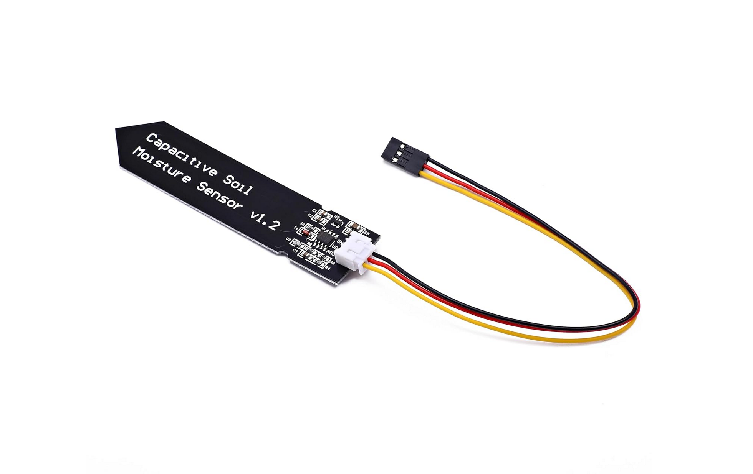
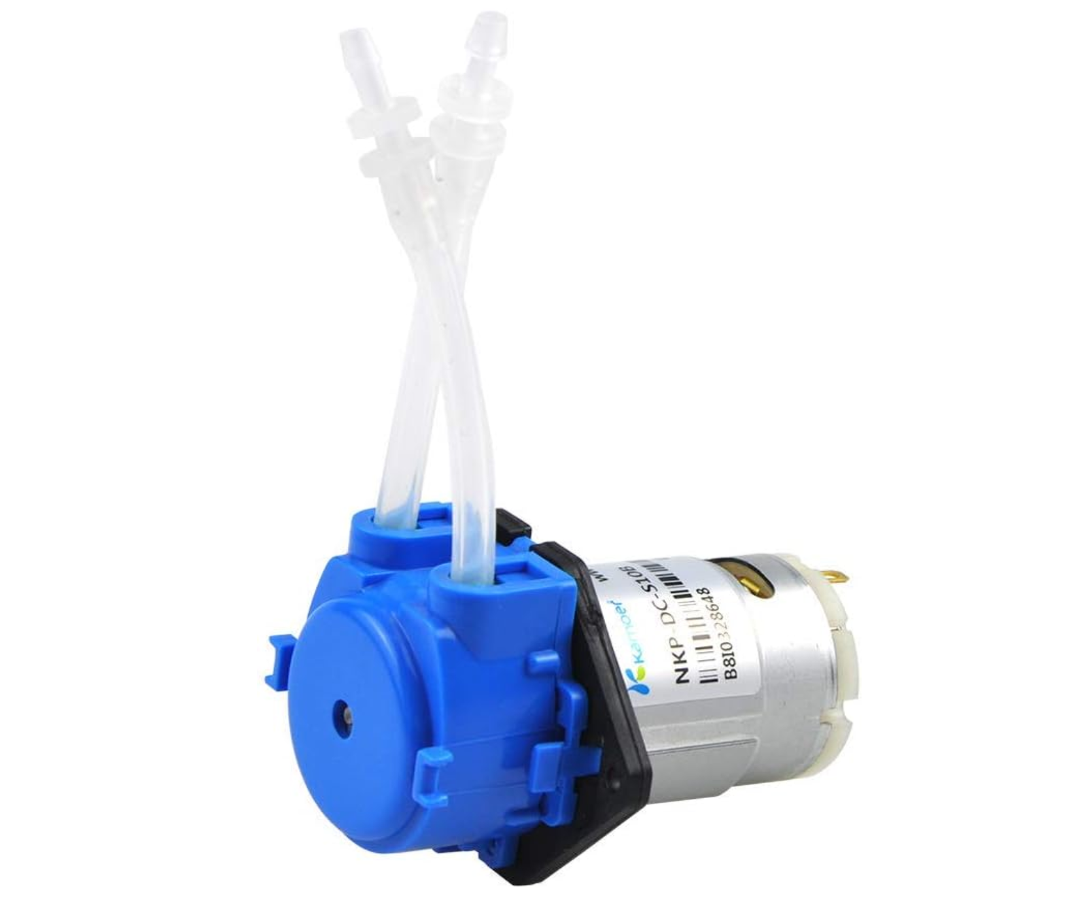
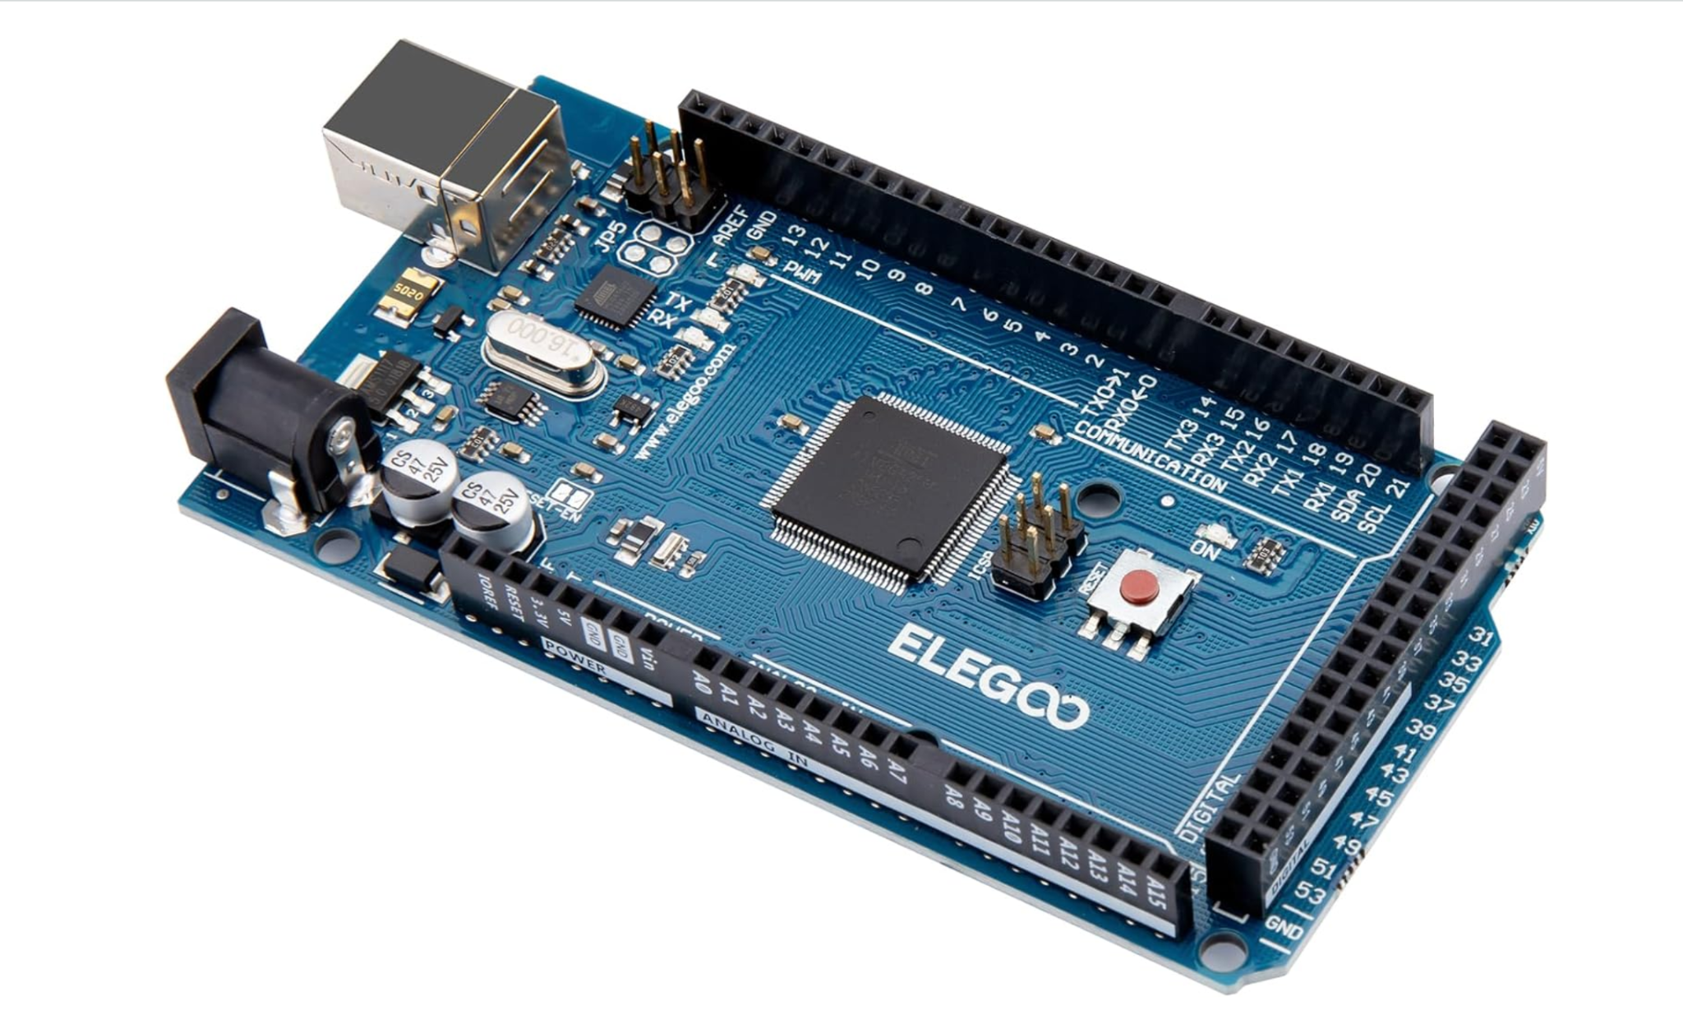
Parts
Capacitive Soil Moisture Sensor
Peristaltic Pump
Arduino Mega 2560

Slide 5
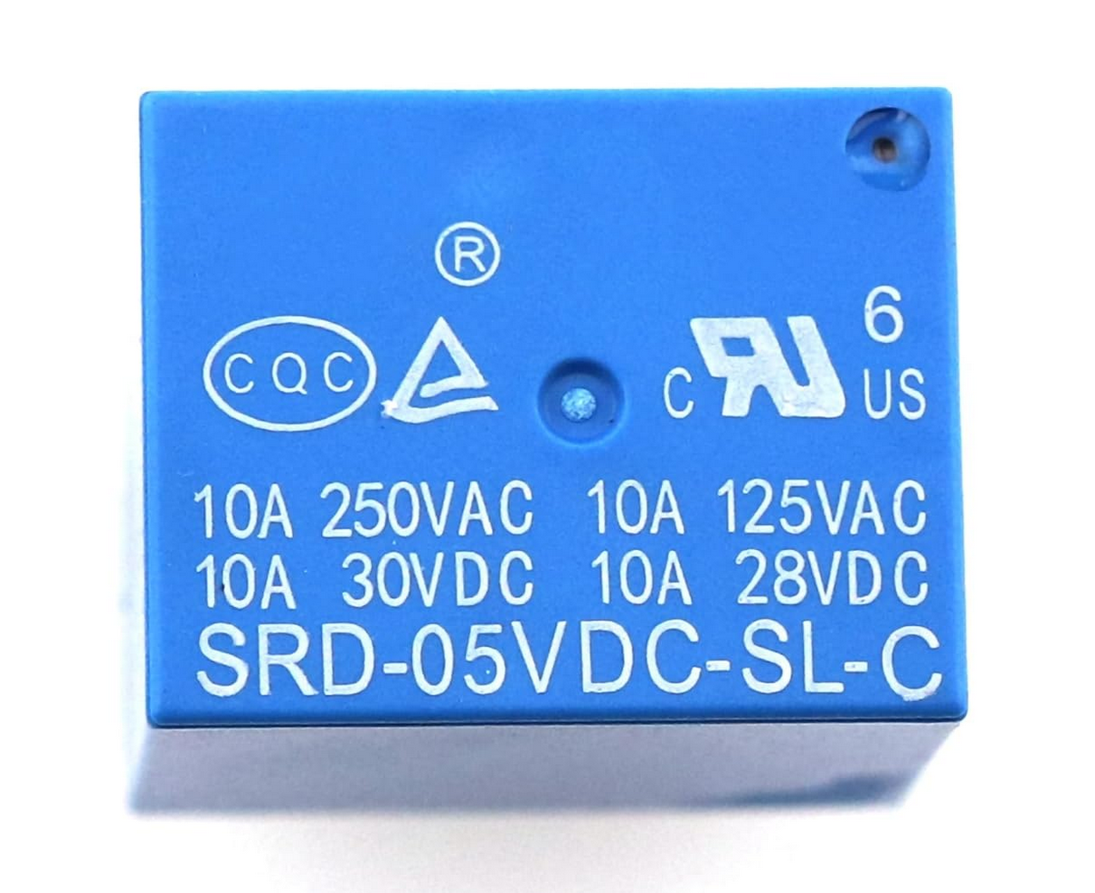
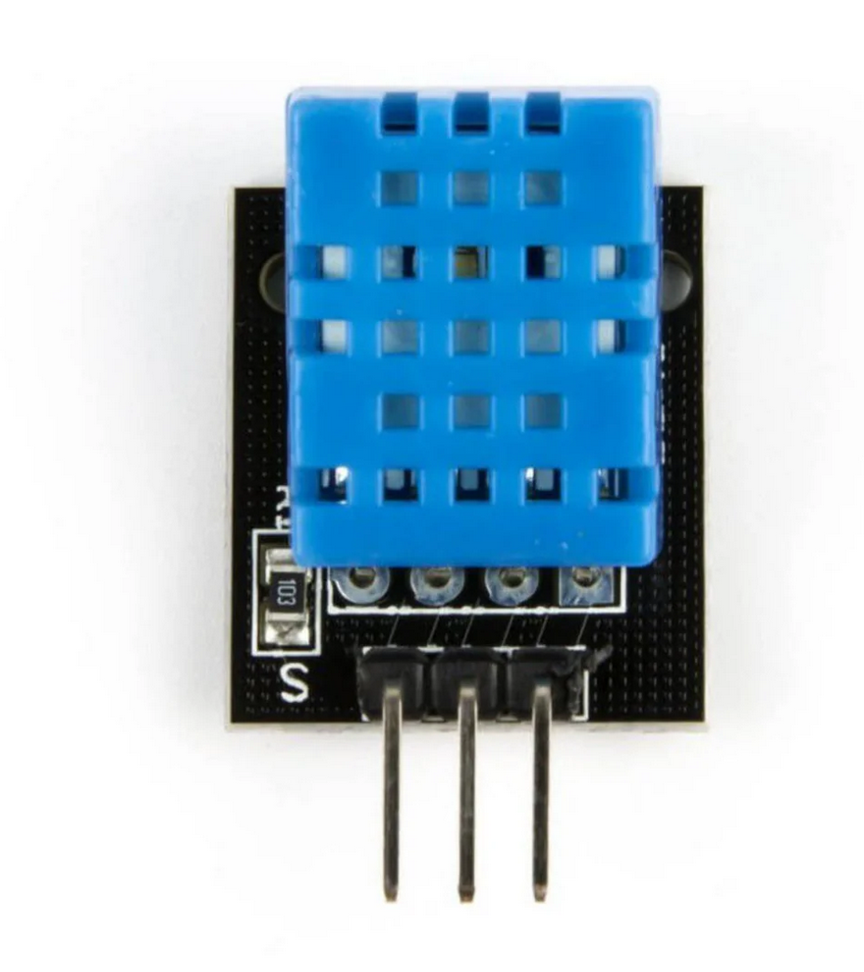
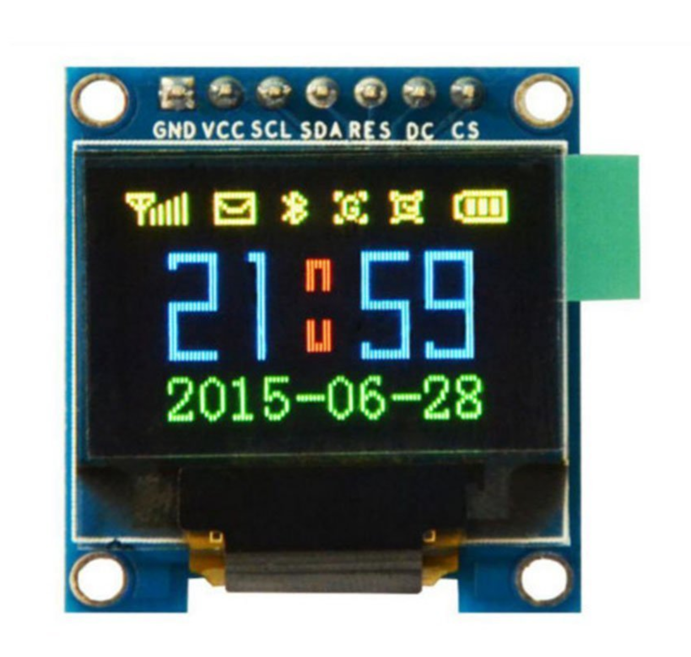
Parts (Cont.)
5V Relay
DHT11 Temperature and Humidity Module
OLED Display Module SSD 1331 96*64 Resolution

Slide 6
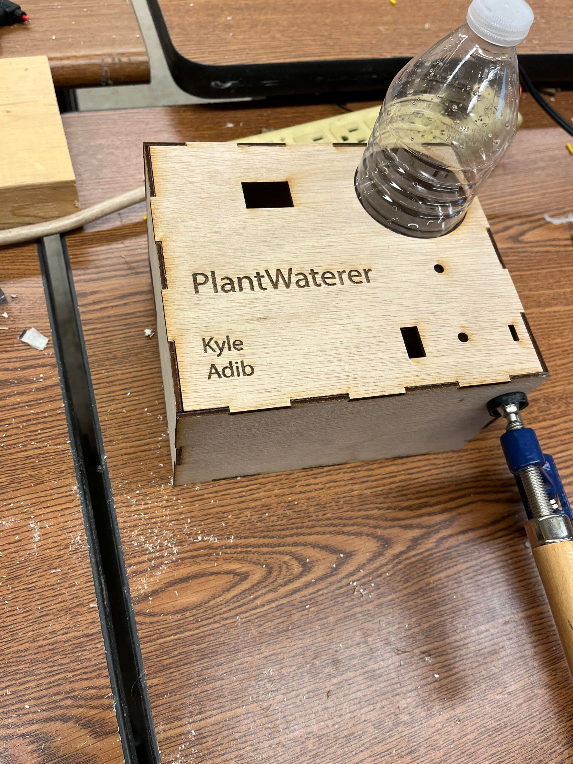
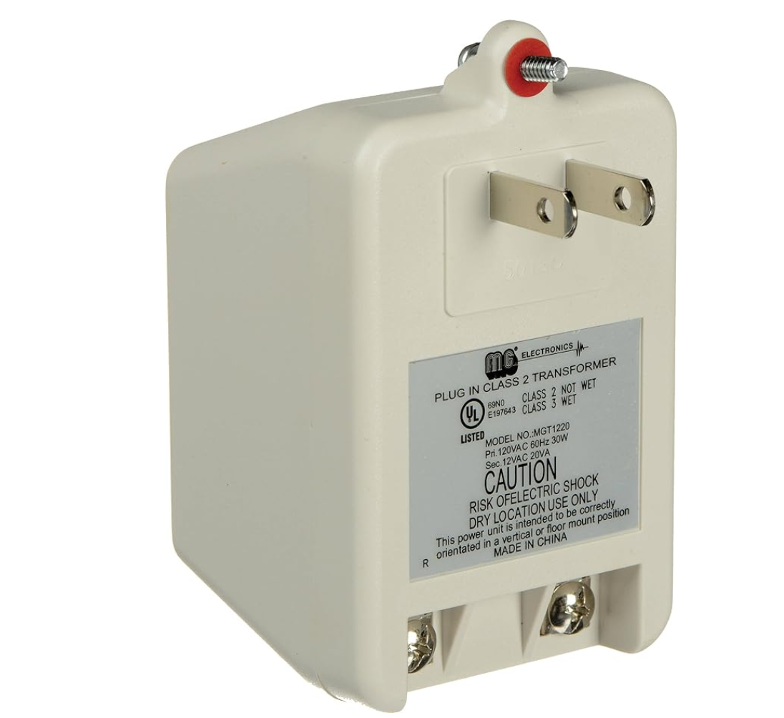
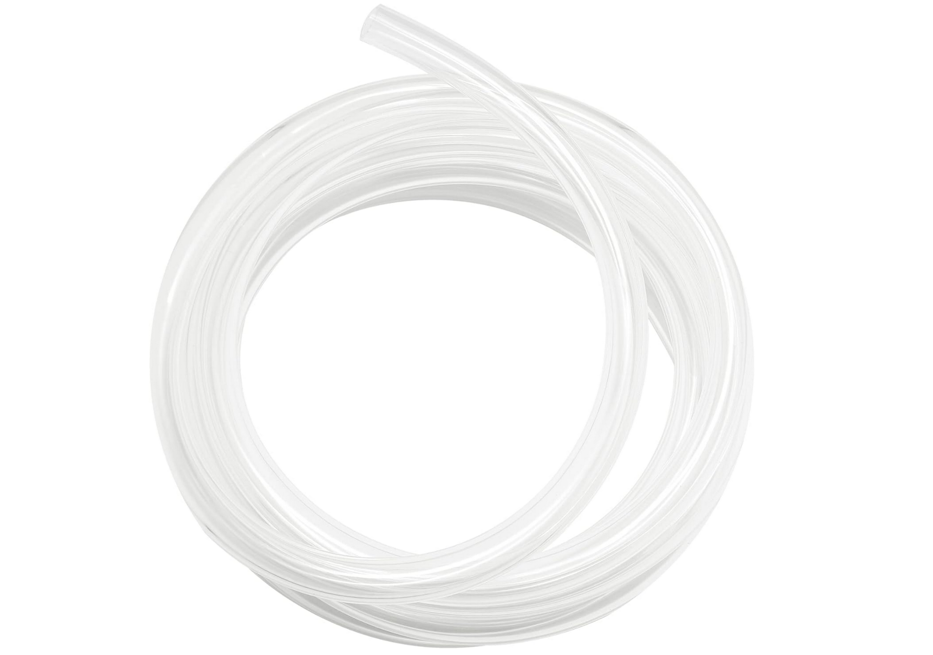
Parts (Cont.)
Laser cut box
Power Supply AC Adapter
5mm diameter clear tubing for the pump

Slide 7
Challenges
Getting the display to work properly
Display was not showing anything at all despite following online tutorials
After getting display to turn on, it only showed random static, was not able to do a lot of things it should be able to do: show multiple colors, fill the screen with
Tutorials online for the display did not work properly, we had go through multiple libraries for similar models of displays
Even then, nothing worked so we had to slowly debug exactly what the issue was, and call a completely different function to initialize the display and enter our own values for pin numbers
Getting dimensions correct when designing laser cutting / 3d printing files for the physical components
Powering everything with one adapter - burnt out an arduino board

Slide 8
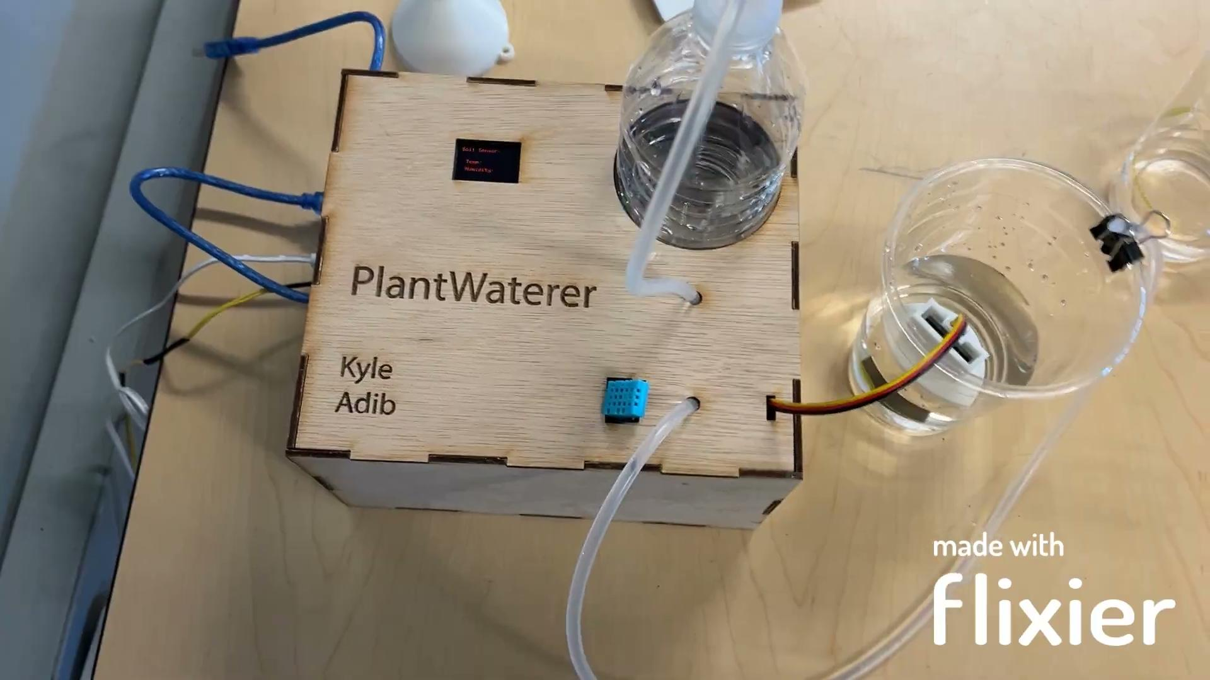
Live Demo:
Backup Video:

